Slide 1

Robert Piggott C.E.
Schools
Multiplication
Grace, Courage and Friendship

Slide 2
Robert Piggott c.e. Schools
Tuesday 18 th November 2025
Aims of this afternoon
How to support your child to learn their multiplication facts
Notes:
We want children who have automatic recall of facts- long term belief MM

Slide 3
Why the focus on multiplication facts?
They help your child in multiplication and division lessons
Government Multiplication check in Year 4
Notes:
MM Cognitive load- if they know facts thye can concentrate on understanding the methods of long mult and division and fractions- no pass mark/ fail but 22 + / 25 is a good score Just multiplication bUT we teach for understanding relationship between X and division

Slide 4
Progression in acquiring facts
We start counting in 1s from Early Years- this is the beginning of time tables!
Year 1- 2,5,10s ( counting in these numbers)
Year 2- 2,5,10 & 3 ( counting in these numbers)
Year 3- 2,5,10,3 ,4 & 8
Year 4 – 6,7,9,11,12
Notes:
MM Doubles then 1s and reduces amount they need to learn- model this Square numbers Kangaroo maths sheet

Slide 5
Rote counting
Skip counting
Rolling numbers
Ordering numbers
Ashley Downs multiplication booklet
Notes:
FS Model skip counting along a line, rolling numbers with actions, ordering the numbers in the table Research HEARING and SEEING- singing gives rhythm to the pattern, seeing can store it in memory- there is a place for it BUT not exclusively, some children need to know where the numbers come from- if struggling

Slide 6
Funkey Maths
Notes:
FS Free resources or paid cards- on website

Slide 7

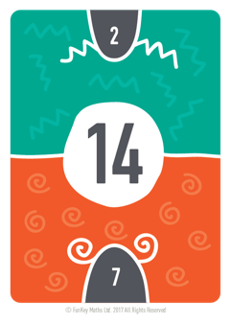
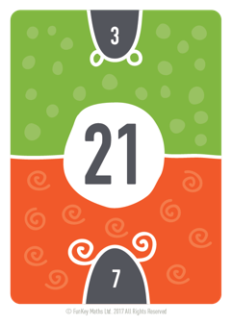
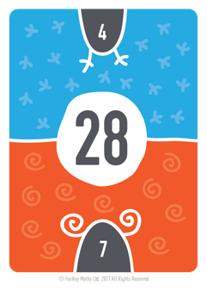
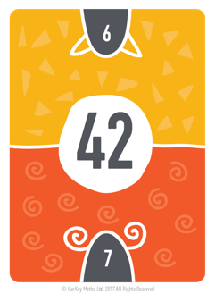
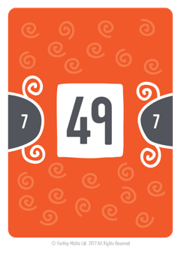
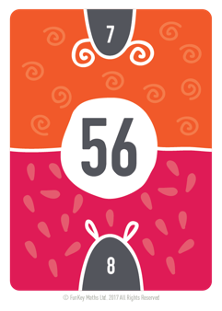
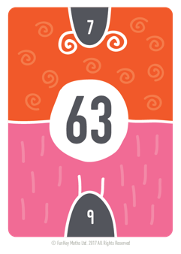
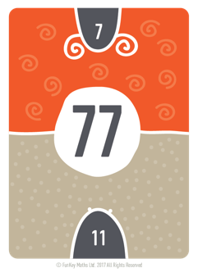
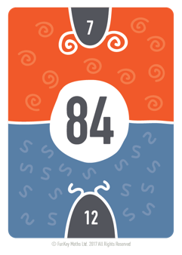
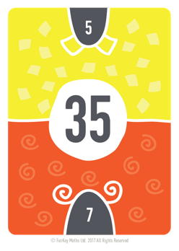
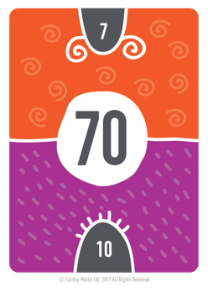
Step counting in 7s
Notes:
FS PPT, or arrange them in order- notice the pulled down Look at repeated addition 7 + 7 ( should be a known fact) 14 + 7-adding 7 each time, let them extrapolate to prove this if needed

Slide 8
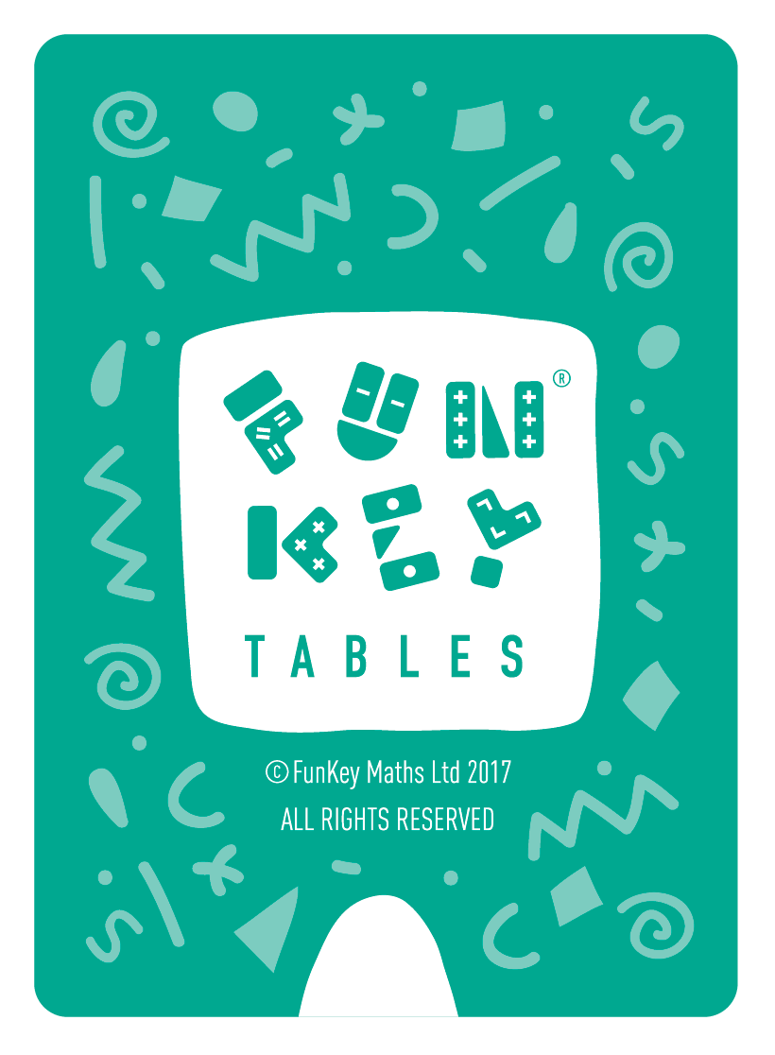
Step counting in 7s
Notes:
FS Turn over the first one- tap and say in order 1 7 is 7 etc and BACKWARDS

Slide 9
Step counting in 7s
Notes:
FS1 7 7 etc forwards, backwards BUT two cards turned over now

Slide 10
Step counting in 7s

Slide 11
Step counting in 7s

Slide 12
Step counting in 7s

Slide 13
Step counting in 7s

Slide 14
Step counting in 7s

Slide 15
Step counting in 7s

Slide 16
Step counting in 7s

Slide 17
Step counting in 7s

Slide 18
Step counting in 7s

Slide 19
Step counting in 7s

Slide 20
Step counting in 7s
Label the numbers odd, even etc
What do you notice?
Notes:
MM Odd even activity look at patterns in target X table and discuss Point is to look for patterns- indicator of good mathematician and some children find patterns easier

Slide 21
Step counting in 7s
Spot the doubles
Notes:
MM double 7 is 14 7 is 1 group of 7. 14 is 2 groups of seven. Double 14 is 28 14 is 2 groups of 7. 28 is 4 groups of seven. Double 28 is 56 28 is 4 groups of 7. 56 is 8 groups of seven. Double 21 is 42 21 s 3 groups of 7. 42 is 6 groups of seven. Double 42 is 84 42 is 6 groups of 7. 84 is 12 groups of seven. Double 35 is 70 35 is 5 groups of 7. 70 is 10 groups of seven.

Slide 22
Make a numberline with the cards
Ask pupils to shuffle their twelve multiples and place them face down on the table.
Ask your child to take it in turns to take a card and create a number line in front of them.
Remind them about the highest and lowest multiples and where 5x and 10x might go.
Your child places their cards into the number line, adjusting the position of the other cards as they go.
When all the cards have been laid out, check the sequence by step counting up or down.
Repeat this activity again and again, until they can do it in about a minute.
Notes:
FS

Slide 23
Play Steal
Your child closes their eyes.
You steal one of the twelve multiples and lays the rest out in random order.
Your child now opens their eyes, and their job is to re-order the cards to work out the missing multiple.
Once they have correctly identified the missing multiple, the card is returned, and count up to check that order has been restored!
Notes:
FS

Slide 24
TTRS
Use TTRS 10 minutes a day, min. 15 min a week
Jamming – choose your own times tables
Gig – 5 mins to answer 100 times tables questions
Garage – creates a heatmap so children/we can see which times tables they struggle with
Studio – develops speed
Soundcheck – like MTC test
6 seconds is the time used on MTC
Paper games- scatter
Notes:
MM Research on last years data nationwide shows impact of 15 mins a school week average score on MTC was 22/25 ( target number!)
Jamming has no timer, sound check is the MTC check times and layout

Slide 25
finally
Little and often
It isn’t just rote learning, looking at the numbers in order helps
Learn relationships between numbers
Kenny’s pouch
Notes:
FS Can roll numbers in car, at dinner table
Just 15 mins a week can support your child Remind them they already know many of the facts- 1x, 2x, 5x,10x , doubles, reduces the number of facts they need to learn- model with 3 X table and

Slide 26
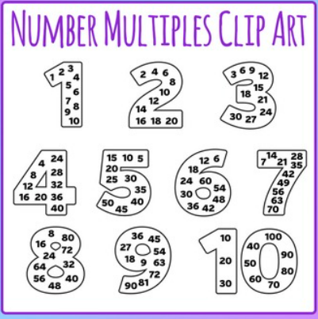
Thank you

