Slide 1

Robert Piggott Junior and Infant Schools Governors
Updated July 2026

Slide 2
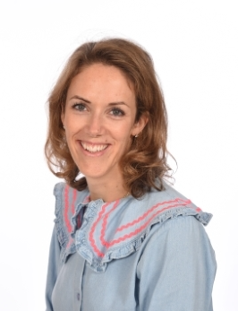
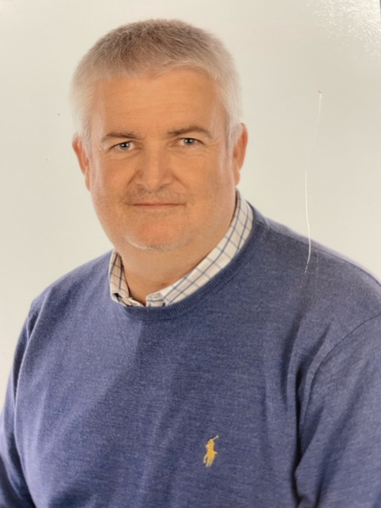
Benedicte Perowne
Co-opted Governor
Chair of the Full Governing Body.
Re, Geography & History Governor
Benedicte became a co-opted governor in 2019. She lives in Wargrave and has one son at the Infant School and one son at the Junior School.
As a lawyer who regularly advises large global and national banks and other financial organisations on their governance structures and their obligations as a result of being regulated entities. Benedicte brings extensive experience to the governing board.
She often works with her clients to draft and interpret policies and procedures and adherence to the same and she enjoys using her skillset to support the school team and the governing board in a number of areas.
Benedicte is also an active member of the local community and is passionate about ensuring our thriving schools remain at the centre of our lively and engaged local community.
Benedicte’s term is from 11.11.19- 13.7.29
David Jeary
Co-opted Governor
Vice-Chair of the Governors
Maths Governor
David was appointed to the Governing Board as a Parent Governor in 2014 and is now a Co-Opted Governor. He has two children who have both attended the Infant and Junior Schools and are now in secondary education.
Having spent 6 years as a Parent Governor he now has an appreciation of the pressures that the whole school team works under and thus the support that can be given by the Governing Board to assist in ensuring the children’s education is at the highest possible standards.
David’s term is from 4.7.18 – 13.7.29

Slide 3
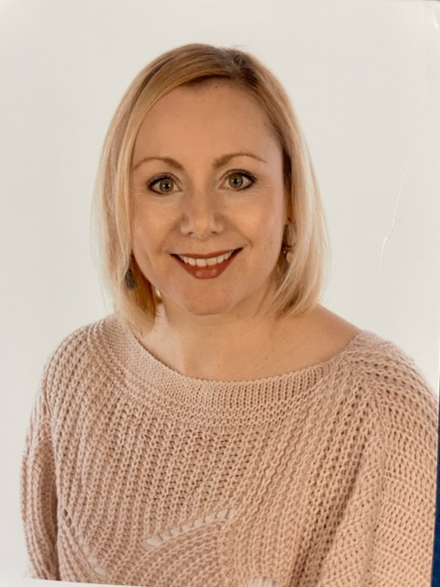
Sally Reason
Co-opted Governor
SEND, Inclusion and PP
Governor
English Governor
Sally became a Co-opted Governor in October 2019.
She has been a teacher for over 20 years with a background of teaching in secondary schools and FE colleges with a focus on special needs. Sally is currently working as a SENCo at Heathfield School. Sally oversees the Curriculum and Standards committee and has responsibility for SEND and Pupil Premium.
Sally has been involved with the school for many years as chair of the PTA whilst her daughter attended and then as part of the Governor body.
Sally’s term is from 11.11.19 – 13.7.29

Slide 4
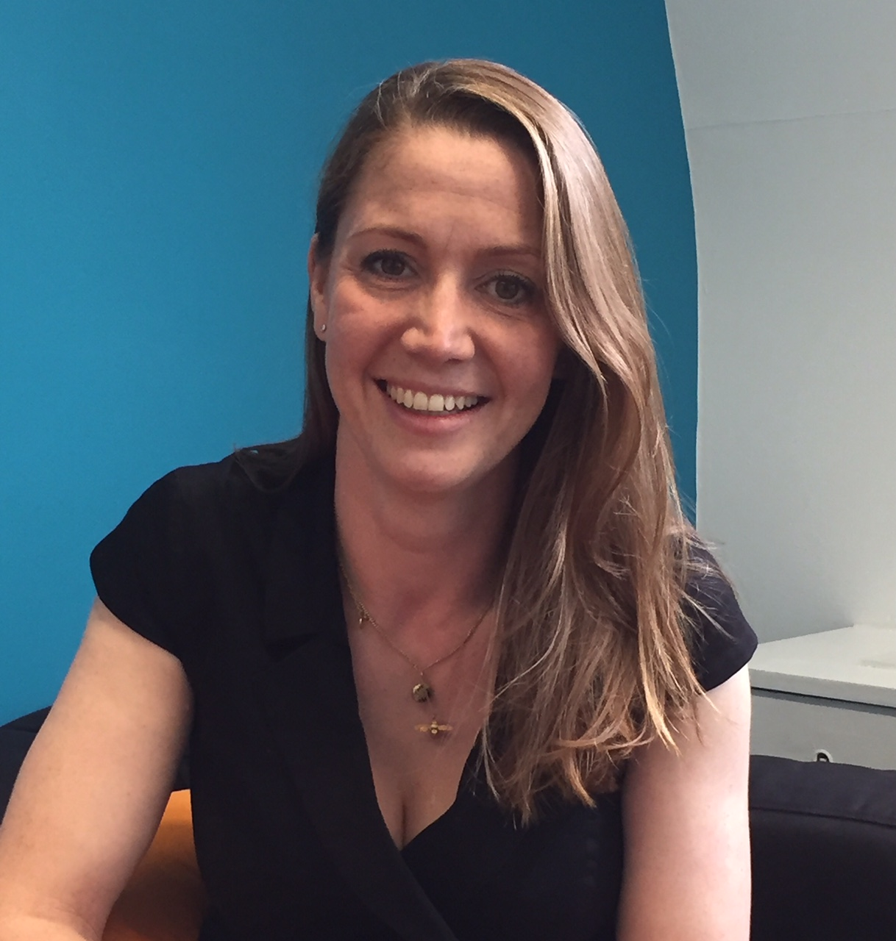
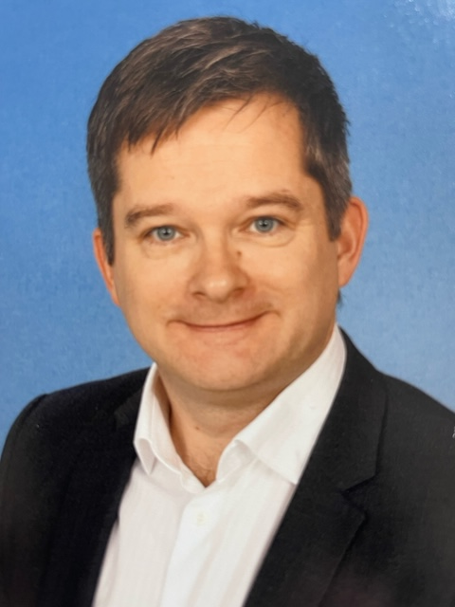
Catherine Hall
Parent Governor
Safeguarding Governor
Catherine joined the board in 2025 as a co-opted parent governor. She lives in Wargrave and has one child at the school and another at Waingels, with additional special educational needs. This has given her a parent view of SEND and how important it is to get it right in schools.
Catherine is a leadership development consultant working with boards of directors to increase performance and to get the best out of their teams. Starting her career in Human Resources and running a consultancy has given her a good understanding of business across the board.
Catherine’s term is from 17.3.25- 16.3.29
Mike Smith
Parent Governor
DT and Art Governor
Mike was appointed to the Governing Board as a Parent Governor in July 2018. He has two children in the schools.
Mike has many years of business experience with a significant number of those years in global human resources. Mike has partnered with a charity in South Africa, Living Legends who support over 8,000 children in schools around Stellenbosch.
Mike is looking applying his knowledge and skills to ensure our children have the best possible education and experience.
Mike’s term is from 4.7.18 – 10.7.26

Slide 5
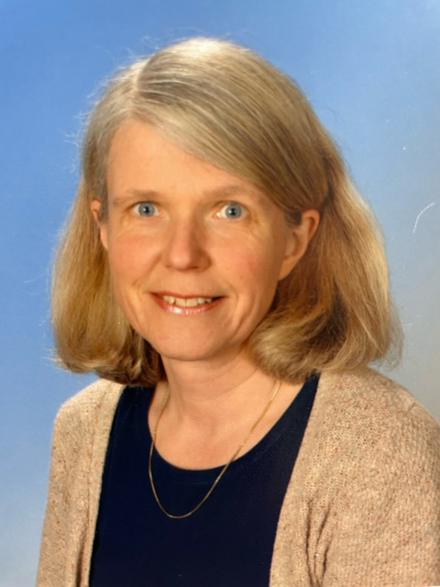
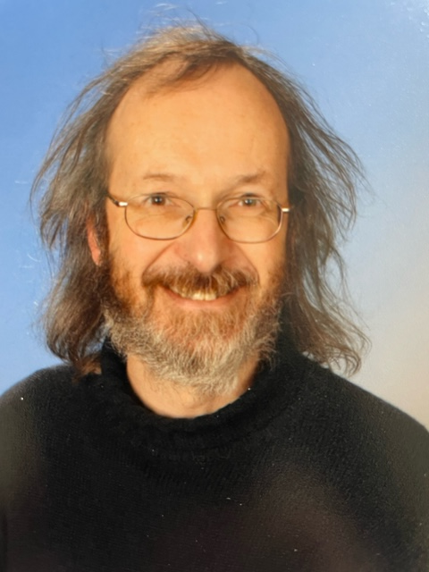
Elizabeth Sutcliffe
Foundation Governor
Maths Governor
Member of:
Pay Panel
Performance Management panel
Liz has been a Foundation Governor since 2002 and teaches Classics in Reading.
Elizabeth became a Governor when her children were at the school and she continues to support the school by bringing her teaching knowledge to the Committees.
Liz’s term is from 6.2.19 – 5.2.27
David Wyatt
Foundation Governor
Christian Distinctiveness, RE,
Geography and History
Governor
Member of:
Personnel Committee
Performance Management panel
Pay Panel
David has been a Foundation Governor for many years. His focus is on Personnel, Finance and the schools’ Christian ethos. He is the Link Governor for Data Protection. David is also Vice-Chair of Governors at Crazies Hill Primary School and is also a Trustee of the Agape Multi Academy Trust.
David’s term is from 3.12.14 – 2.12.26

Slide 6
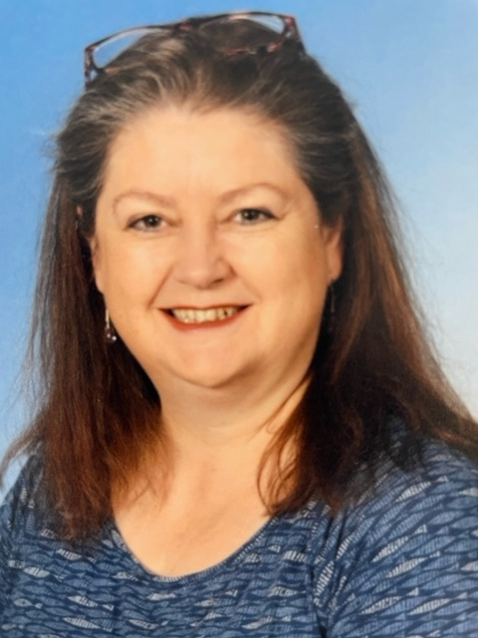
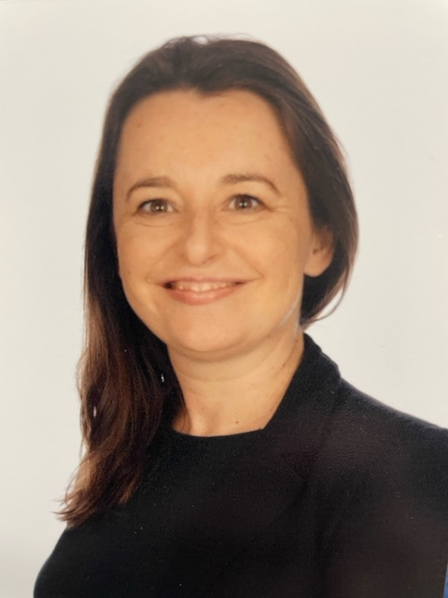
Ali Sinfield
Co-Opted Governor
Ali has been a member of the Governing Board for two terms as the Staff Governor. Ali is now a Co-Opted Governor, invited to be on the Board due to her unique and extensive skills and expertise.
Ali is the Assistant Headteacher and Inclusion Lead across both schools. She Leads our school’s inclusion strategy for SEND and Pupil Premium, with a passion for ensuring every child has the opportunity to succeed.
Additionally, Ali oversees the curriculum to ensure it is engaging, inclusive, and aligned with the highest standards of education. She is committed to continuous improvement and to making a positive impact on both teaching and learning outcomes across the school.
Ali’s term is from 6.10.25 – 5.10.29
Vanessa O’Byrne
Executive Head Teacher
Vanessa became the Executive Head in September 2023. She recognises the importance of working with the whole school community to provide a broad, stimulating and value-based education for our pupils.
An important part of her role will be aiding communication between the Schools and Governing Board. With a focus on the School Development plan, Vanessa will provide regular data and progress reports to the Full Governing Body.
Vanessa’s interests lie in curriculum development, providing a range of platforms for all children to shine as well as the moral and social education of pupils through our values of ‘Grace, Courage & Friendship’.

Slide 7
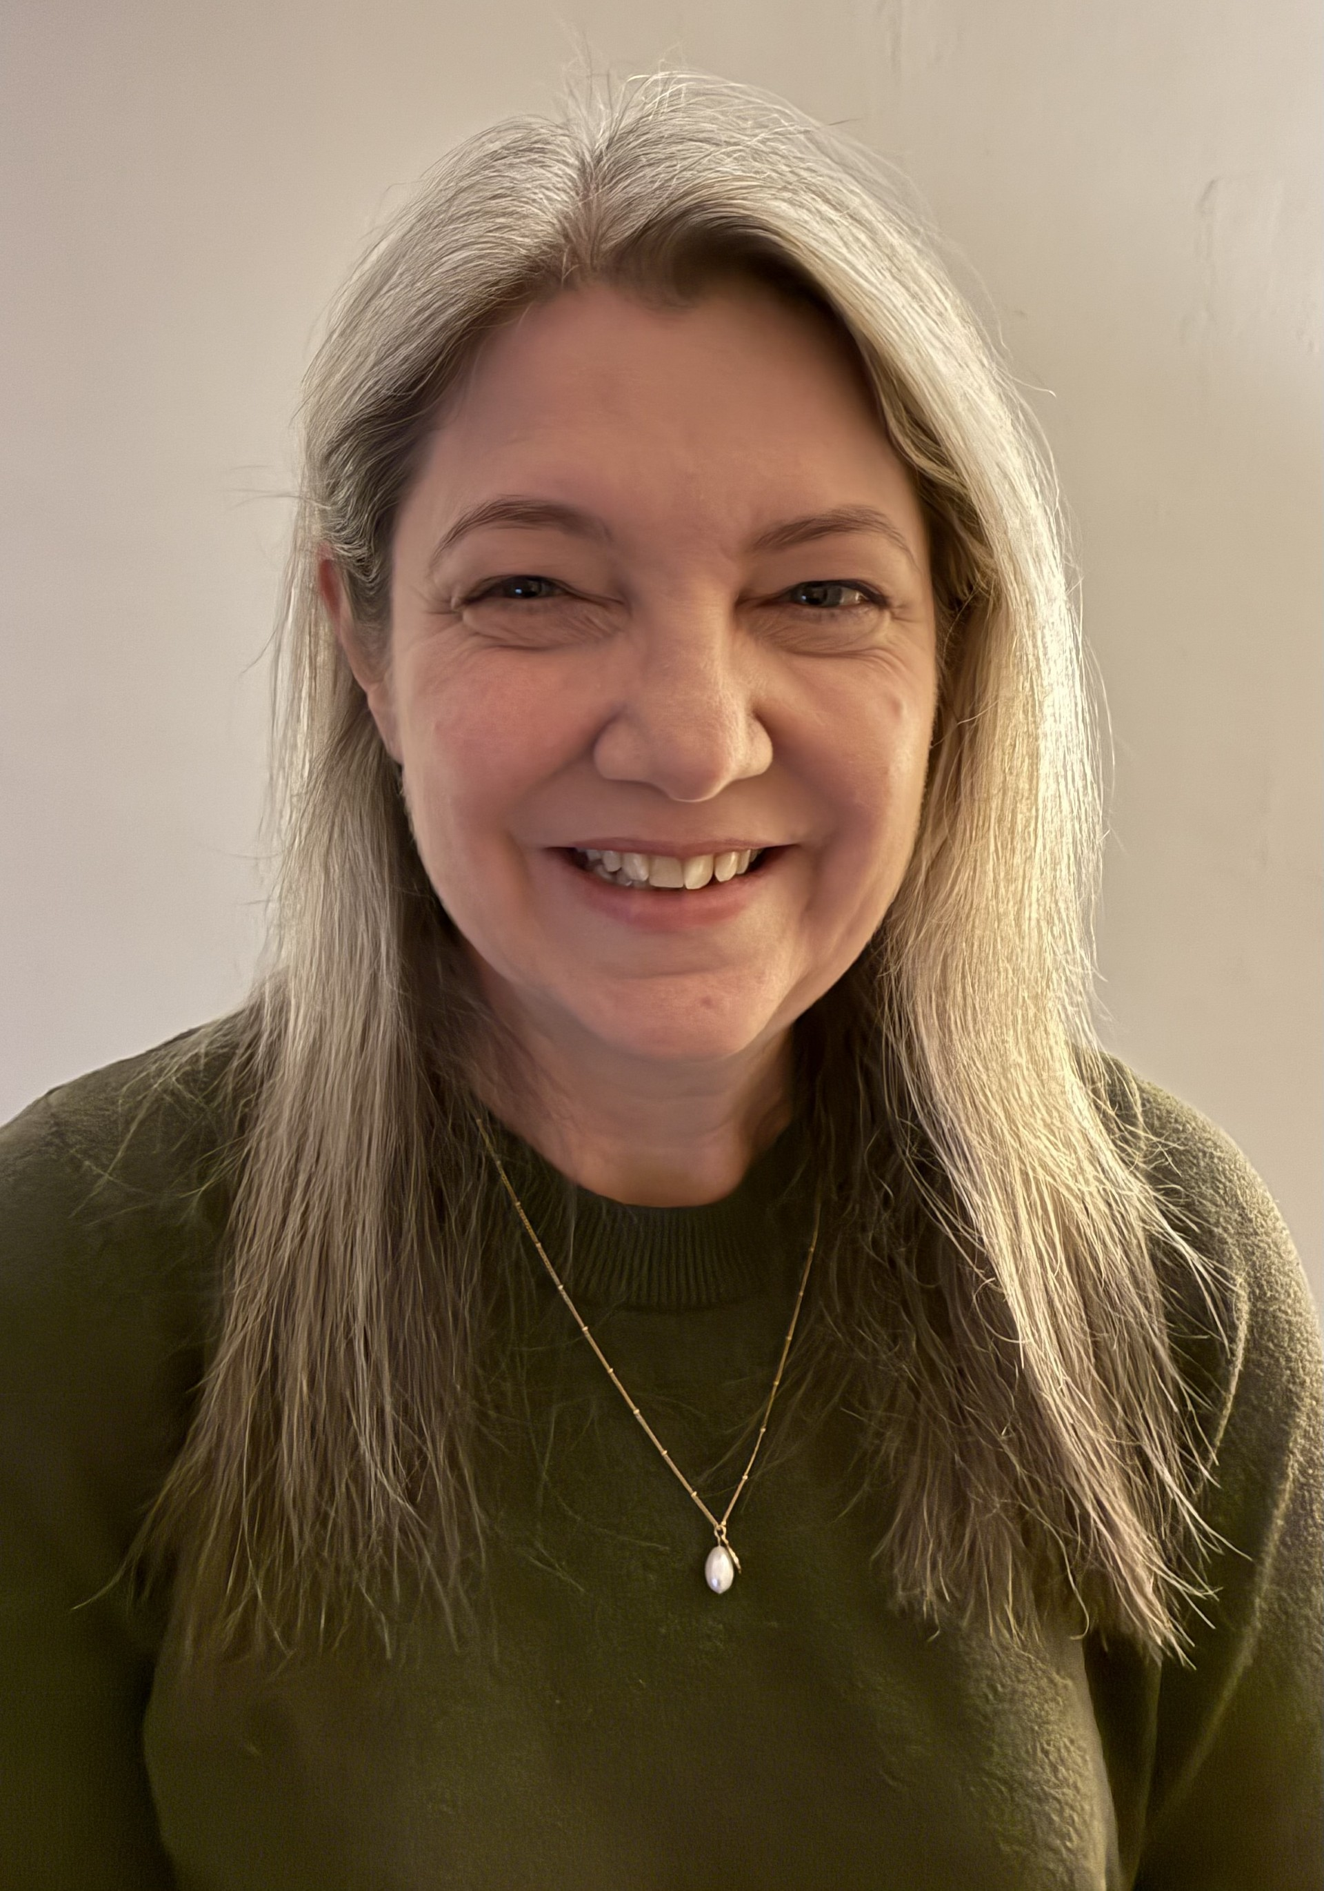
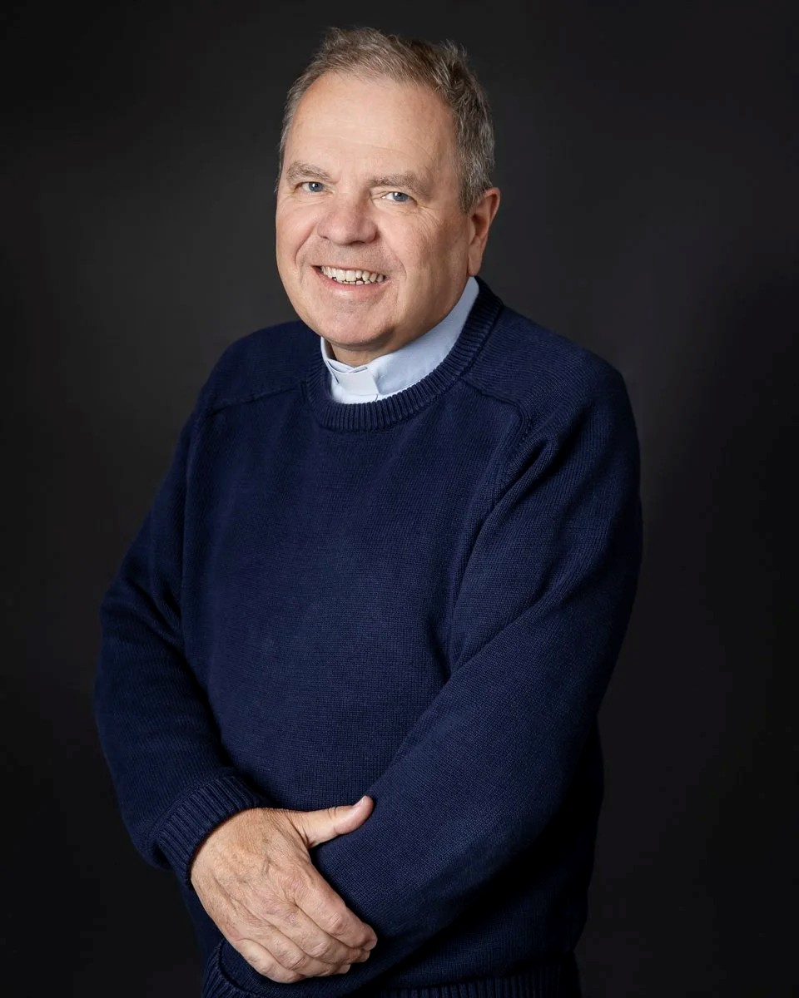
Reverend David Chislett
Foundation Governor
David is the vicar of Wargrave and Knowl Hill and became a governor in October 2025. He is part of the team that leads collective worship at Robert Piggott CE Infant and Junior School.
David is also on the board of governors of The Piggott School and a trustee of USPG who are partners in global mission.
In his business career, David held senior financial positions with several private equity backed technology companies.
David’s term is from 22.10.25-21.10.29
Sarah Pontet
Staff Governor
Sarah was elected as the Staff Governor, joining the Governing Board in November 2025. Sarah has been a teacher for 30 years, the past 15 at Robert Piggott Junior School. She is Assistant Head and as well as teaching Year 5 and 6, takes the lead in the schools on Safeguarding, Behaviour and Attendance.
Sarah is committed to supporting the strategic development of our schools and ensuring that decisions reflect the realities of teaching and learning. She is passionate about creating an inclusive environment where every pupil can flourish and ensures that the curriculum meets all the children's needs.
Sarah’s term is from 12.11.25 – 11.11.29

